Slide 1

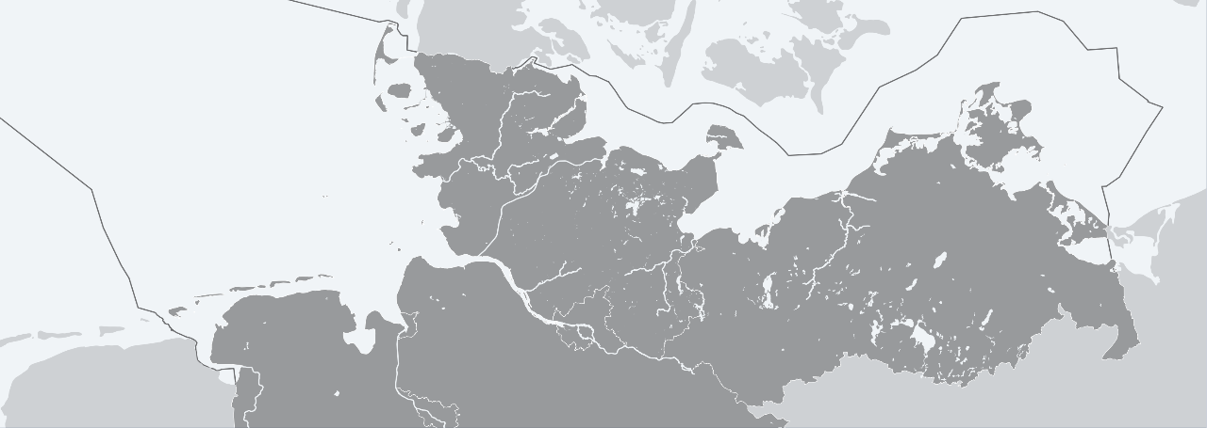

The Renewed Marine Data Infrastructure Germany - MDI-DE
Henning Gerstmann, Kirsten Binder, Johannes Melles, Jochen Krause
Data Science Symposium 2023, June 09
www.bfn.de
Mirko Hauswirth (BfN)
H. Gerstmann (BfN), K.Binder (BAW), J. Melles (BSH), J. Krause (BfN) | Data Science Symposium | 2023-06-09

Slide 2
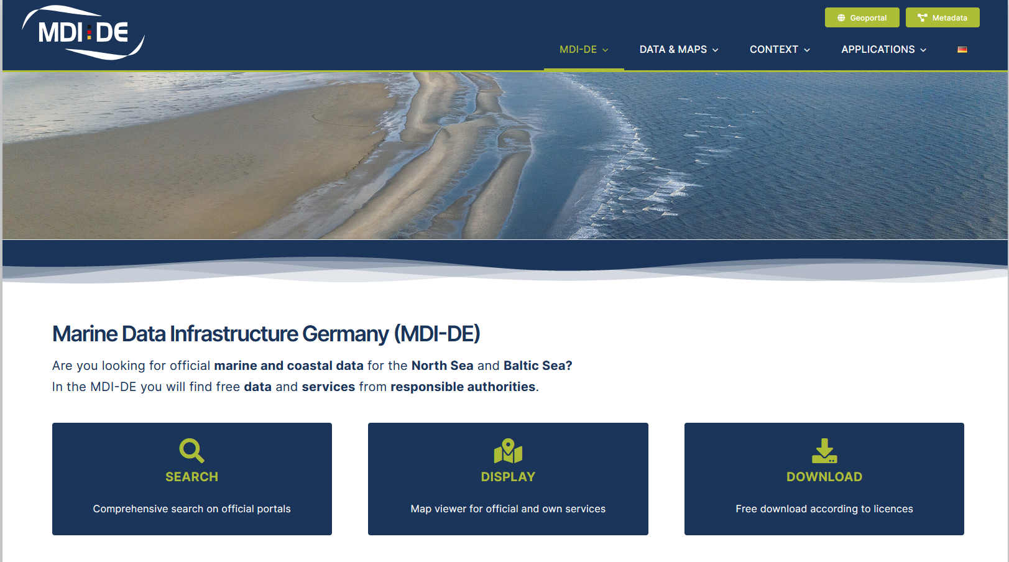
Introduction
“Marine Spatial Data Infrastructure is a type of cyberinfrastructure that facilitates the discovery, access, management, distribution, reuse, and preservation of hydrospatial data.”
Contarinis, S., and Kastrisios, C. (2022). Marine Spatial Data Infrastructure
Who needs marine governmental data?
  Government & administration
  Research
  Private companies & NGOs
  General public
Why do we need a marine SDI?
  Administrative data is distributed widespread over authorities SDIs
  Marine and coastal data usually not included in “terrestrial” SDIs
  Most recent geometry datasets (e.g. reporting units)
https://projekt.mdi-de.org
Notes:
Specialised Spatial Data Infrastructure

Slide 3
Introduction
Why do we need a marine GDI ?
  Marine area is increasingly important in various fields
  Administrative data is distributed widespread over authorities SDIs
  Marine and coastal data are usually not included in “terrestrial” SDIs
  Most recent geometry datasets (e.g. reporting units)
Who needs marine data?
  Government & Administration
  Private companies
  Researchers
  NGOs
  General public
Notes:
- Blue Economy

Slide 4



Scope and Principles
Single Point of Access for governmental geodata services, metadata and other information
Harmonisation of web services provided by the partners
Tool for supporting national reporting obligations for EU directives (MSFD, WFD) and regional conventions (OSPAR, HELCOM)
Applied Standards:
© Sangya Pundir (Source)

Slide 5










Background
Project history
  Research project (2010 – 2013) funded by BMBF
  since 2014: continued as permanent environmental information system
  2021-23: Complete revision of the geoportal
Lower Saxony
Schleswig - Holstein
Mecklenburg - Vorpommern

Slide 6





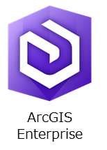


Concept & Implementation
Geoportal
Visualisation
Download
Metadata
WMS
WFS
WFS
ATOM
XML
Loose connection
Harvesting
CSW
Distributed Spatial Data Infrastructures
SDI MV
SDI BfN
SDI NDS
SDI BSH
SDI SH
SDI BAW
Notes:
Maybe some know the old MDI (old fashioned and poor user experience)
Layout recognition with MetaVer, Geoportal.de …

Slide 7

Implementation
MDI-DE
Web page
Mapping
Metadata
Specialised Apps
Geoportal
GDI-DE,
DAM
…
CSW
WMS WFS
WCS CSW
Project homepage
Distributed SDIs
Metadata Search Engine
Web GIS
Specialised applications
Distributed Geodata Infrastructures

Slide 8
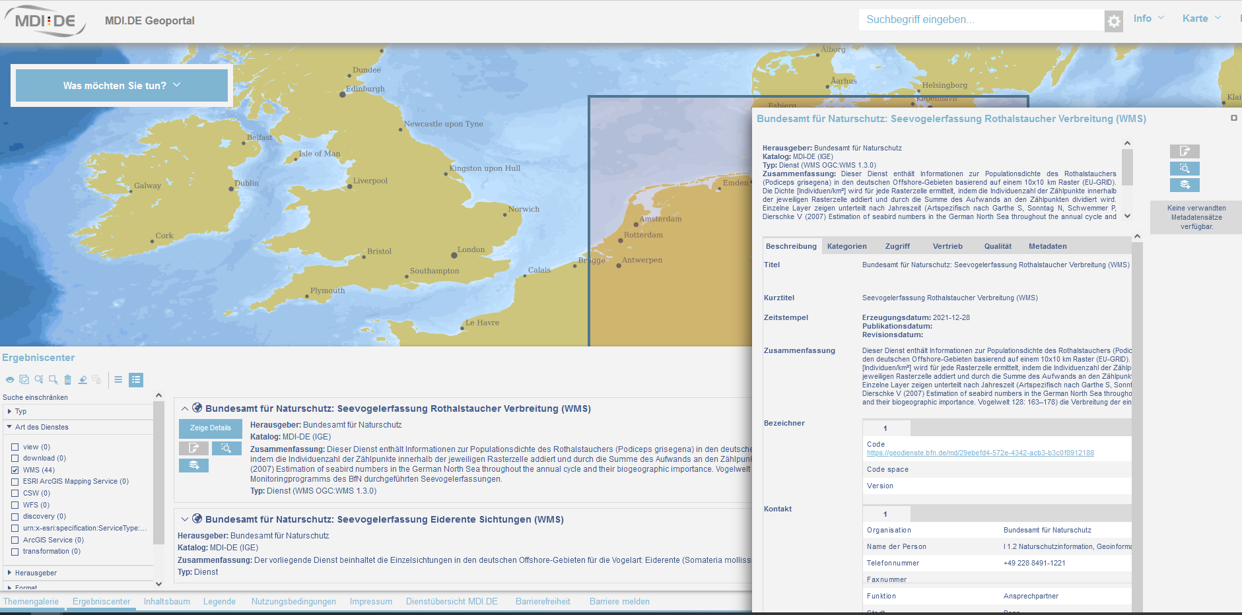
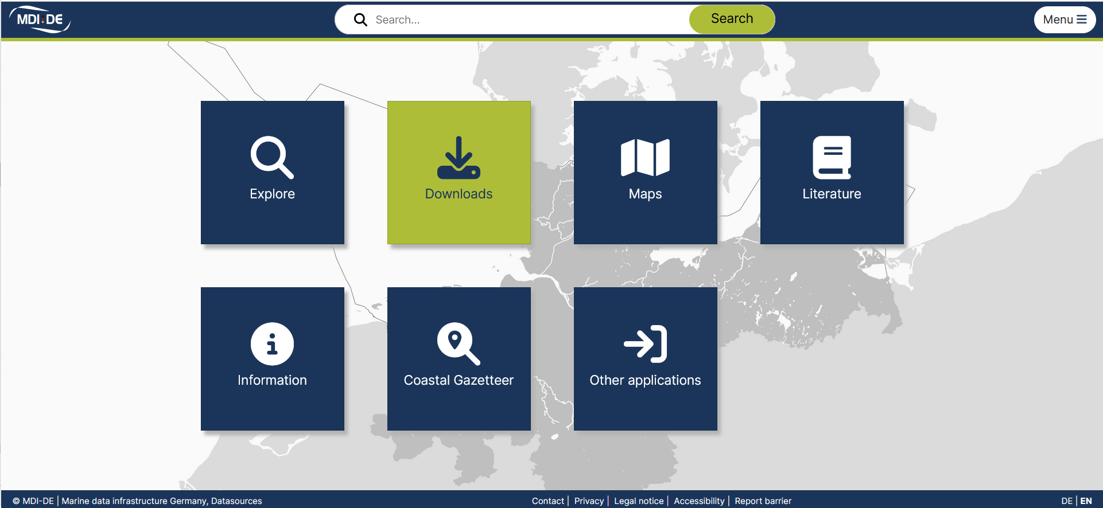
MDI-DE: Portal
Metadata Catalogue
Web GIS
Geographical name service
https://mdi-de.org
Notes:
- Published this Tuesday

Slide 9
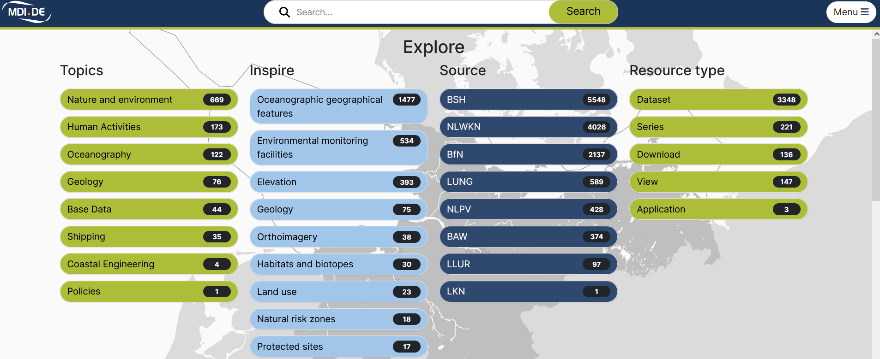
Contents
> 3.000 View, Feature and ATOM services
https://mdi-de.org/mdi-de/#/explore

Slide 10
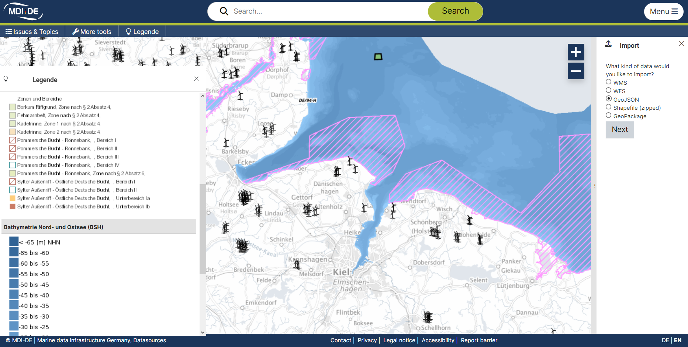

MDI-DE: Map Viewer
Pre-configured thematic maps
Individually composable maps: Import, Export, Sharing, Customisation

Slide 11
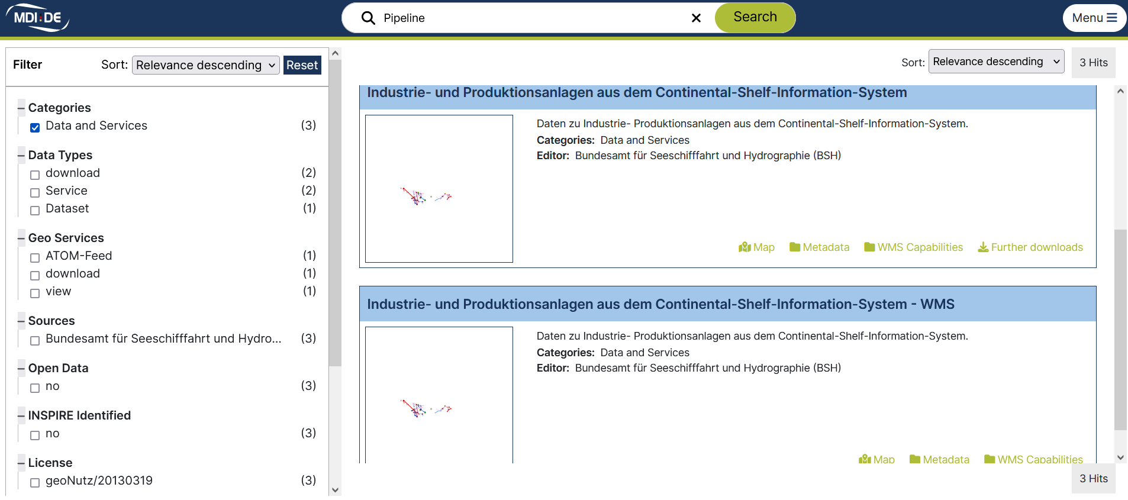
MDI-DE: Metadata Catalogue
Harvesting of catalogues of the partners via CSW
Filter criteria and various interactions

Slide 12
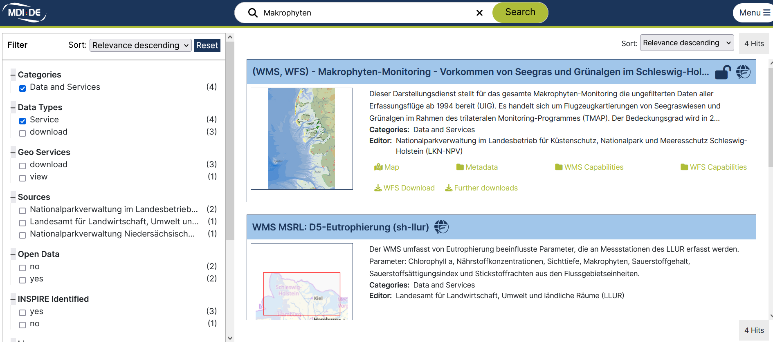
MDI-DE: Metadata Catalogue
Harvesting of catalogues of the partners via catalogue service (WCS)
Filter criteria and various interactions
Map display
Show metadata record
Reuse service
Feature Download
Download source data

Slide 13
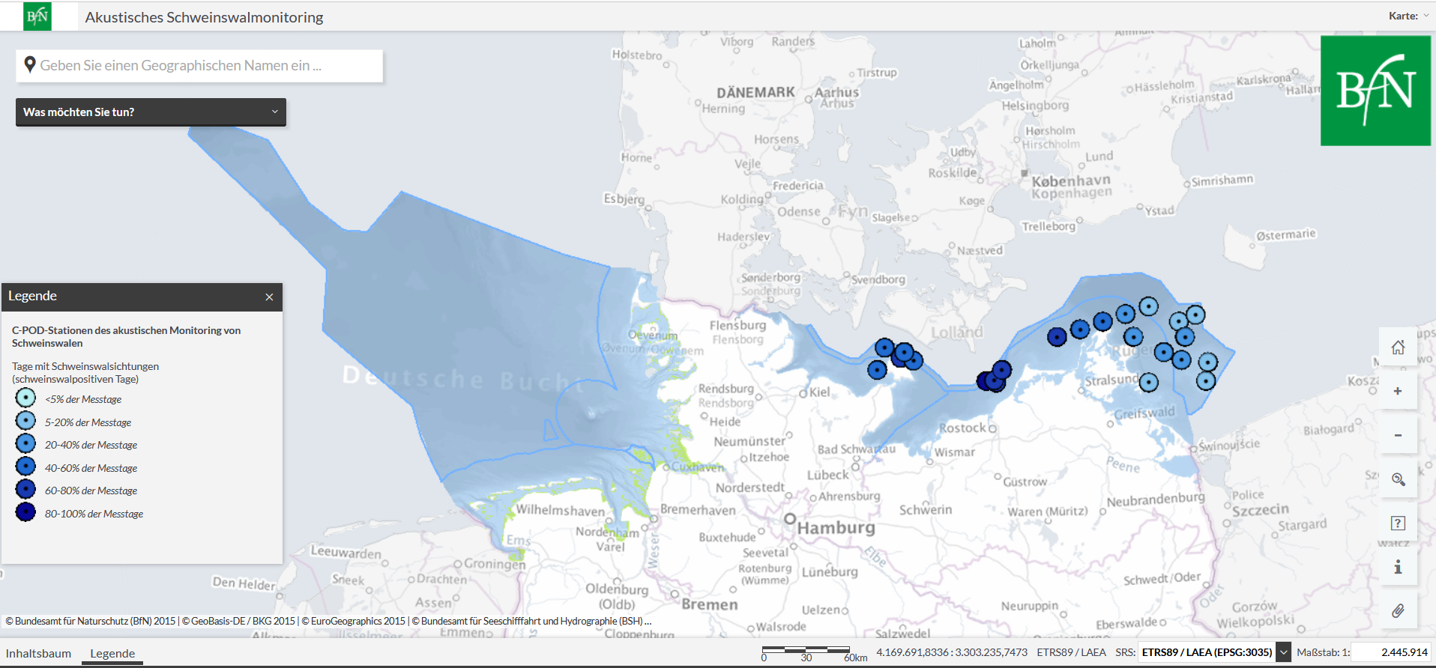
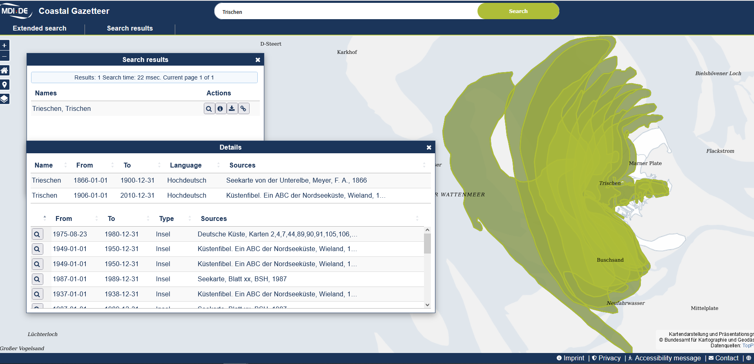
MDI-DE: Specialised Apps
Connected apps of project partners:
C-POD Monitoring of harbour porpoises
https://geodienste.bfn.de/schweinswalverbreitung
Project Associated App: Coastal Gazetteer

Slide 14
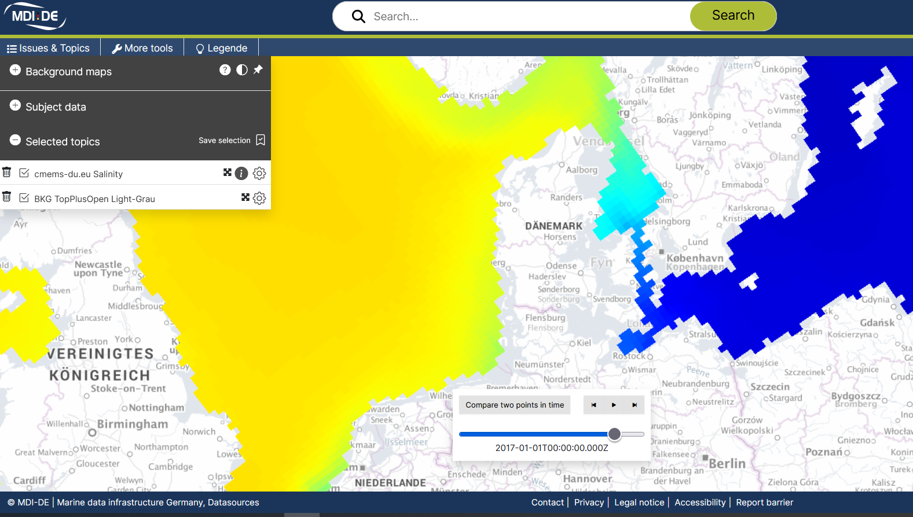
Perspectives
Integration of Copernicus services
Intensify cooperation with DAM, other scientific institutions, authorities
Copernicus-ID: ARCTIC_MULTIYEAR_PHY_002_003 (Sea water salinity, yearly);
DOI: https://doi.org/10.48670/moi-00007

Slide 15
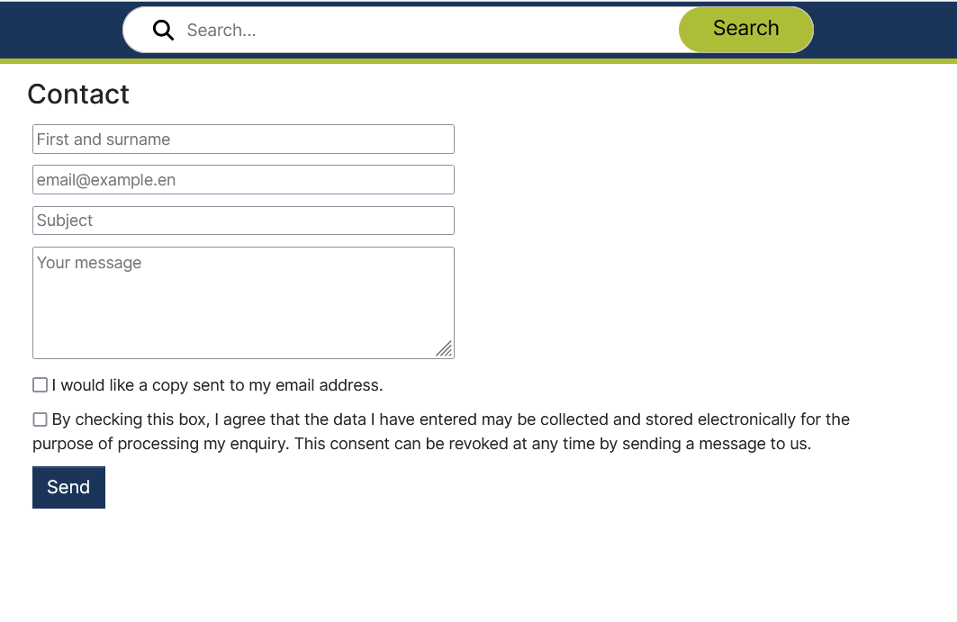
What can you do?
Go to https://mdi-de.org/
Explore MDI-DE
Contact us if
  you found a bug
  you miss contents relevant for your work
  any ideas to further improve MDI-DE
  you have any other inquiry

Slide 16
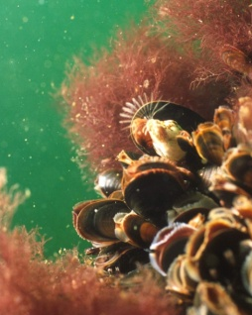
Thank you for attention!
Contact:
Henning Gerstmann
Federal Agency for Environmental Conservation
henning.gerstmann@bfn.de
Jochen Krause/Peter Hübner (BfN)
Bildquelle nicht vergessen

